Slide 2
Trees and Forest
Trees:
A connected graph G without any cycles is said to be a tree.
A graph without cycles is an acyclic graph. Thus, a connected graph G is said to be a tree if G is acyclic.
The graph with one vertex and no edge is the trivial tree.
Forest:
A graph whose components are trees is called forest. The forest has also no cycles.

Slide 3
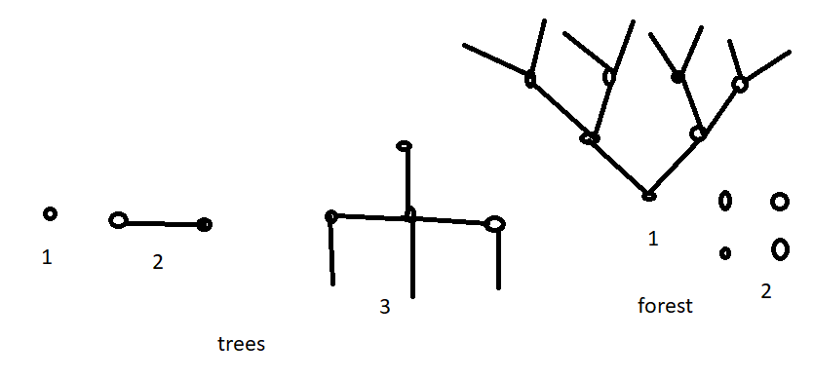
Trees and Forest

Slide 4
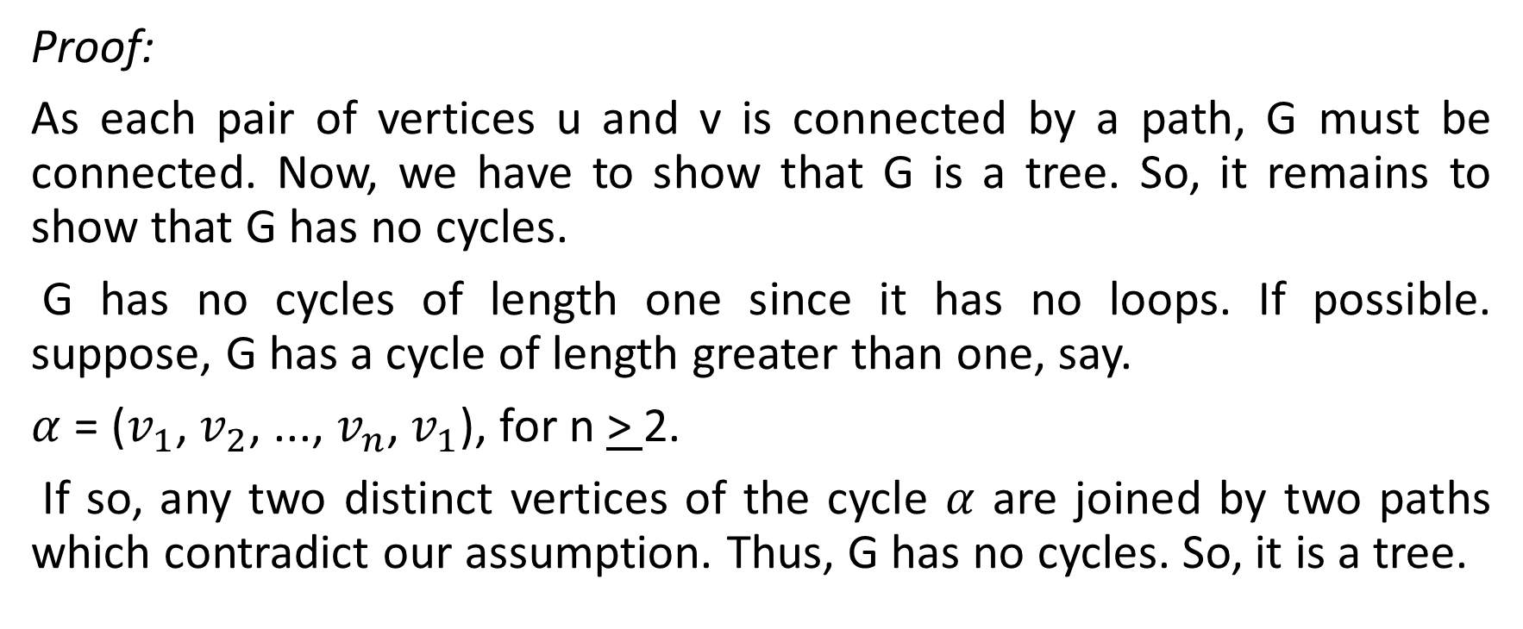
Let G be a graph without any loops. If for every pair of distinct vertices u and v of G there is a precisely one path from u to v, then G is a tree.

Slide 5
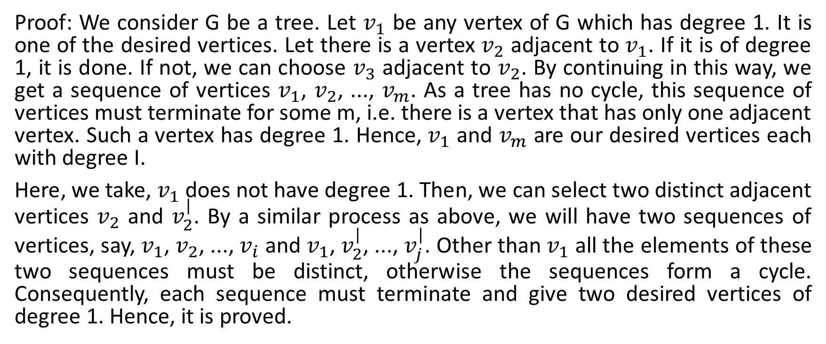
In any tree G, there are at least two vertices of degree 1.

Slide 6
If G is a tree with n vertices, then it has n - 1 edges.
Proof: Let us proceed by the method of induction. When n = 1, then G has only one vertex, then, since it has no loops, G cannot have any edges, so, it has no edges. Therefore, the theorem holds for n= 1.
So, it goes on and the theorem is true for n = k, where k is any positive integer. Now, we will show that the theorem holds for n= k + 1. Let G be a tree with k + 1 vertices and let u be a vertex of degree 1. If we remove such a vertex and the edge incident on it, the subgraph G - {u} is still connected and has no cycles. Thus, G-{u} is a tree. Now, G - {u} has k vertices because G had k + 1 vertices. By our induction hypothesis, the tree G - {u} has k-1 edges. Since the number of edges is less than vertices by 1. It follows that G has k edges, as required. Therefore, if the theorem is true for n = k, then it is true for n=k+1.
In this way, the theorem is true for all positive integers k. It completes the proof.

Slide 7
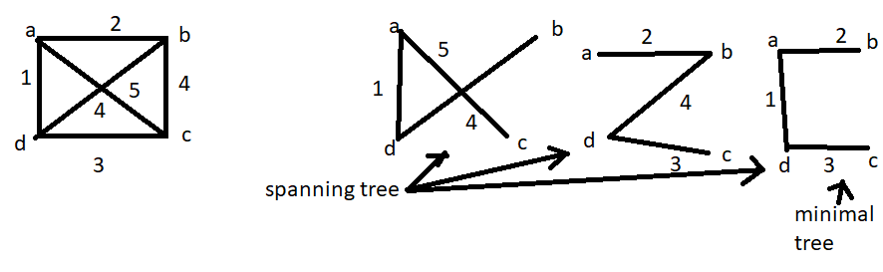
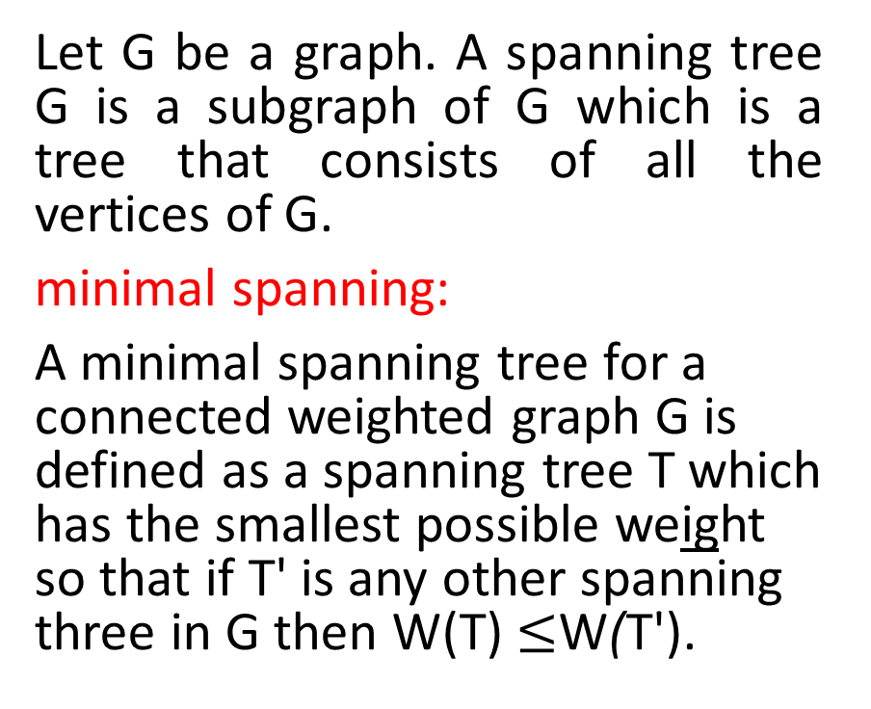
Spanning Tree

Slide 8
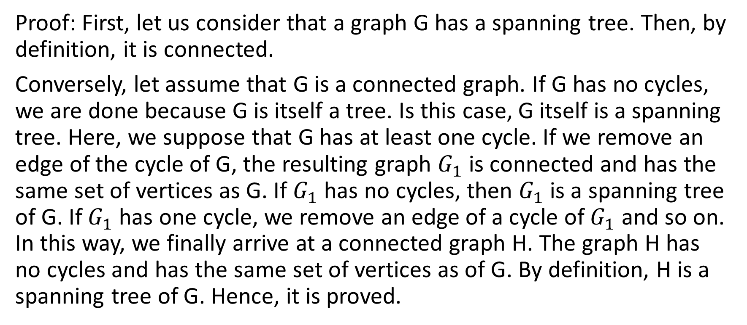
A graph is connected if and only if it has sub-graph that is a spanning tree.

Slide 9


